Slide 1

Exploratory Data Analysis
G2M Insights for XYZ
September 20, 2023

Slide 2

Agenda
Executive Summary
Problem Statement
Approach
EDA
EDA Summary
Recommendations

Slide 3
Problem Statement
XYZ is considering an investment in the Cab Industry due to the significant growth observed in recent years and the presence of multiple key players in the market. As part of their Go-to-Market (G2M) strategy, XYZ aims to gain a comprehensive understanding of the market before making a final investment decision. The challenge is to leverage available data sets to provide actionable insights that will help XYZ identify the most suitable cab company for their investment.

Slide 4
Executive Summary
XYZ, a private firm, is contemplating an investment in the Cab Industry, driven by the sector's recent substantial growth and the presence of several prominent players. To inform their investment decision as part of their Go-to-Market (G2M) strategy, XYZ has tasked us with comprehensively assessing the market. We are provided with multiple data sets, each offering insights into different aspects of two cab companies' customer profiles.
Our project delivery encompasses several key steps:
Source Documentation Review
Field Names and Data Types
Identifying Relationships
Field/Feature Transformations
Merging datasets
Duplicate Removal
NA Value and Outlier Detection
Our approach is centered on generating hypotheses, critically engaging with the data, and employing diverse analytical techniques to yield unique and actionable insights. By harnessing the power of data analysis, we aim to equip XYZ with the knowledge and insights needed to make an informed decision regarding their investment in the Cab Industry.

Slide 5
Approach
1. Data Preparation:
Merge datasets for a comprehensive view.
Organize columns for clarity.
Create new variables for deeper insights.
2. Explore and Understand:
Calculate key statistics to grasp data characteristics.
Visualize relationships and distributions among variables.
Examine correlations to identify associations.
3. Hypothesis Testing:
Chi-Squared Test: Uncover significant categorical relationships.
ANOVA: Detect differences among groups.
Two-Sample t-test: Identify distinctions between two groups.
4. Hypothesis Analysis:
Formulate and test hypotheses based on findings.
Make data-backed recommendations.
5. Conclusion and Recommendations:
Summarize key insights.
Recommend actions for investment decision.

Slide 6
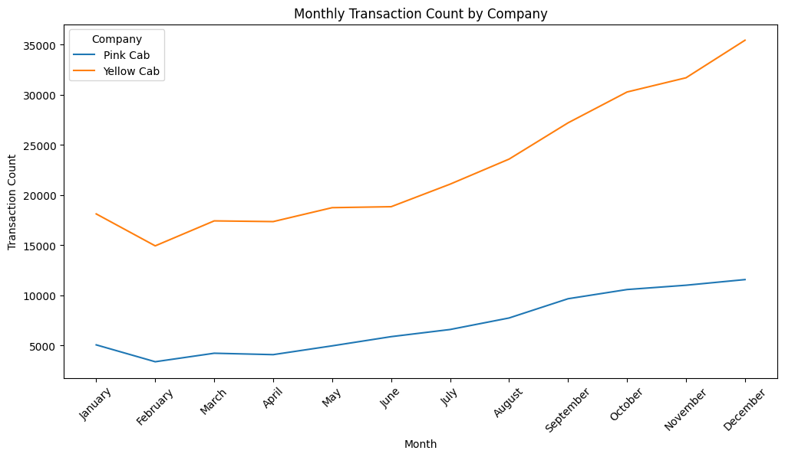

Seasonality Analysis
Observation: Our analysis reveals that both cab companies exhibit a synchronized response to seasonality, indicating that external factors have a consistent effect on the demand for cab services across the market.
Implication: Recognizing this shared seasonality, we proceeded to analyze the relationship between the variable "month" and prices. This investigation is essential, as it indirectly influences the choice of the cab company by users.

Slide 7
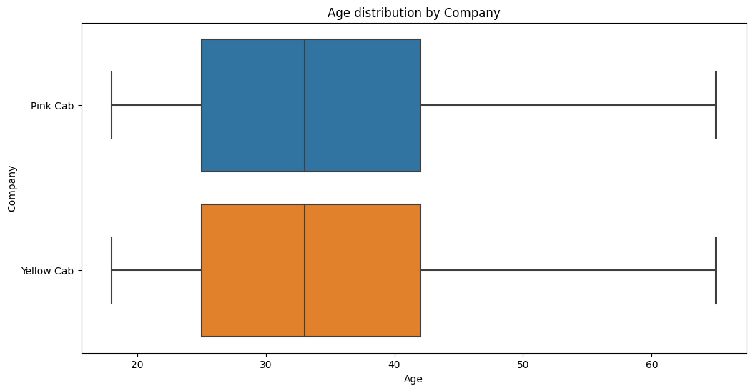
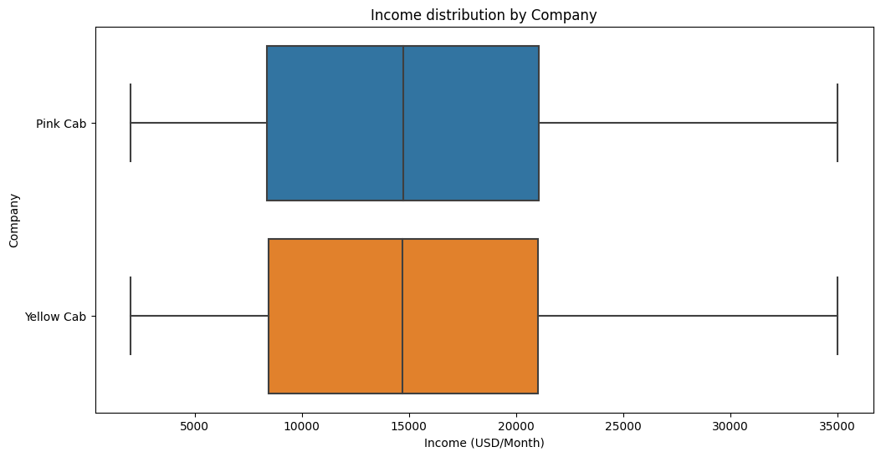
Age and Income Analysis
Observation: Our analysis reveals that neither of these variables have an impact on the user's choice, a hypothesis test was performed which confirmed this observation.

Slide 8
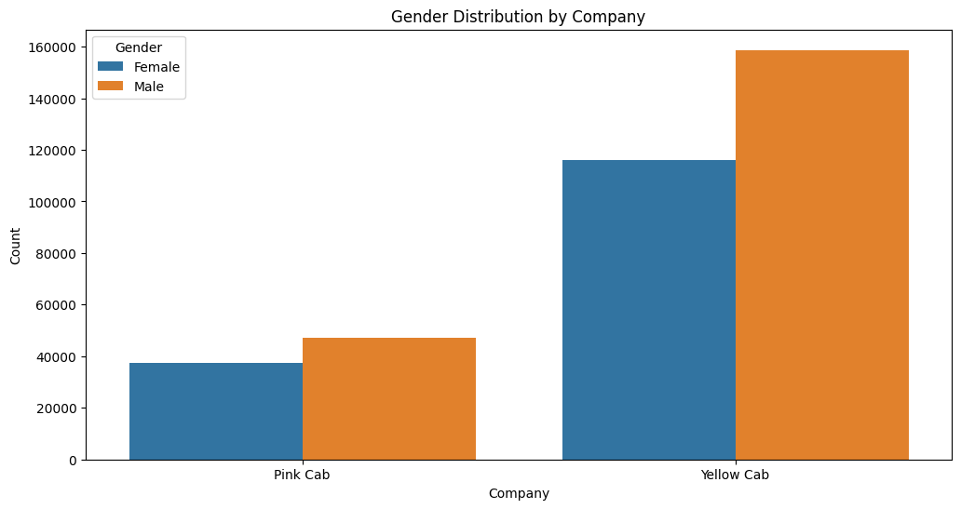
Gender Analysis
Observation: In our analysis, we noticed a subtle gender based preference for yellow cabs. This observation consider the varying gender ratios for both companies
Implication: The gender preference prompt us to delve deeper into this relationship, conducting a hypothesis analysis to determine the association between gender and the cab company chosen.

Slide 9
Recommendations
Seasonality and Price per KM:
It appears that there is a relationship between the price per KM and the month, which could be attributed to seasonality.
It's crucial to investigate if both companies exhibit similar seasonality trends to determine whether the season has an influence on the choice of the company based on price.
Further analysis should explore the specific patterns and differences in price per KM for each company across different months.
Age and Income vs. Company Selection:
The hypothesis testing suggests that neither age nor income have a significant influence on the choice of the company.
These variables may not be strong predictors for determining which company users choose.
While they may not directly impact company selection, it's important to consider other factors or interactions that could influence user choices.
Gender and Company Selection:
Despite a seemingly low correlation in the correlation matrix, the Chi-Squared test reveals a significant association between gender and the choice of the company.
This finding suggests that gender could be a more influential feature in predicting the company chosen by users than initially expected.
A deeper analysis of gender-based preferences and marketing strategies may provide valuable insights into user behavior.
Price per KM as a Predictive Feature:
Price per KM shows the highest correlation with the choice of company, and the ANOVA test confirms a significant difference in mean price per KM between the two companies.
This variable is likely a key feature that can be used to predict the company chosen by users with higher accuracy.
Future modeling and predictive analytics should prioritize the inclusion of price per KM as a predictive feature in company selection models.

Slide 10
Thank You

